Slide 1
Square and cube numbers
Properties of number: factors, multiples, squares and cubes

Slide 2
how to use Oak lessons

Slide 3
I can explain the concept of squared and cubed numbers and calculate them.

Slide 4
A square number is the product of two repeated integers.
Example
Example
2 ✕ 2 =
4
5 ✕ 5 =
25
4 is a square number
25 is a square number
A cube number is the product of three repeated integers.
Example
Example
2 ✕ 2 ✕ 2 =
8
5 ✕ 5 ✕ 5 =
125
8 is a cube number
125 is a cube number

Slide 5

Square and cube numbers
Square numbers
Cube numbers

Slide 6
Square numbers
A square number is the product of two repeated integers.
Example
Example
2 ✕ 2 =
4
5 ✕ 5 =
25
Can you use 4 dots and 25 dots to show why they are called ‘square’ numbers?

Slide 7
Square numbers
A square number is the product of two repeated integers.
Example
Example
2 ✕ 2 =
4
5 ✕ 5 =
25
Can you use 4 dots and 25 dots to show why they are called ‘square’ numbers?
2
5
2
5

Slide 8
Square numbers
Integer | Array | Calculation | Square number
1
2
3
4
1 ✕ 1
1
2 ✕ 2
4
3 ✕ 3
9
4 ✕ 4
16

Slide 9


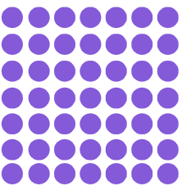
Square numbers
Can you fill in the rest of the table?
Integer | Array | Calculation | Square number
5
6
7
5 ✕ 5
25
6 ✕ 6
36
7 ✕ 7
49

Slide 10

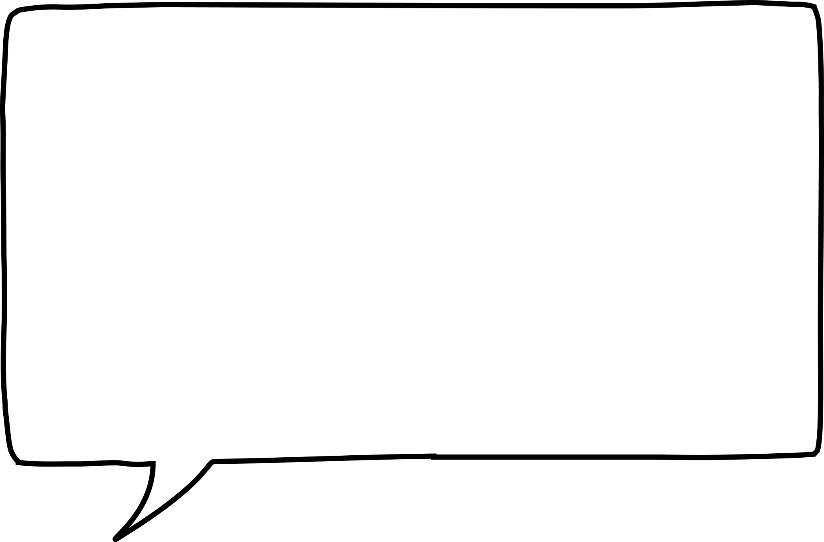
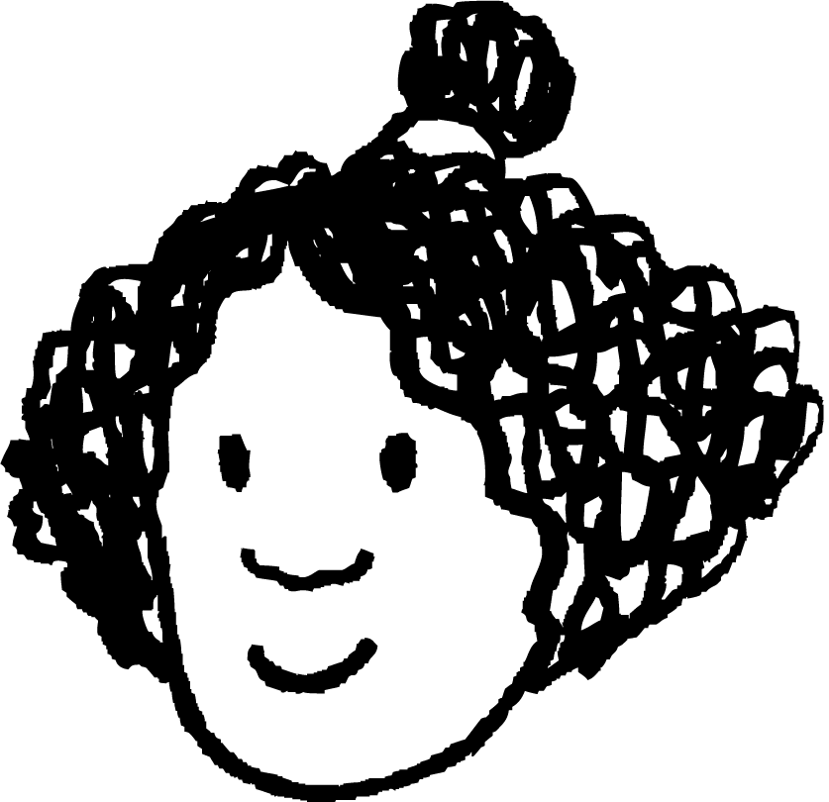
Square numbers
Izzy drew this array. She then says:
I have made a square number because I have used an array with 3.5 dots by 3.5 dots. This means 12.25 is a square number.
Is she correct? Explain.
No. A square number is the product of two repeated integers.

Slide 11

Square numbers
Lucas drew this array. He then says:
This array shows 3 is the square number.
Is he correct? Explain
No, 9 is the square number as it is the product of 3 and 3.

Slide 12
Square numbers
Match up the arrays with the correct square number.
49
25
64
16

Slide 13

Square numbers
2) Work out the age given the clues.
My teacher’s age is:
a square number,
a multiple of 3,
and less than 70.
Alex is a student at Oak Academy.
Alex’s age is:
4 less than a square number and is an even number.
How old is the teacher?
How old is Alex?

Slide 14
Square numbers
3) Identify if the following statements are true or false. Justify your answer.
Statement | True | False | Justification
121 is a square number
13 ✕ 13 = 169 so 13 is a square number
4 add 3 then multiply by 7 gives a square number
7 multiplied by 4 add 3 gives a square number

Slide 15
Square numbers
4) Jun discovers he can sum two different square numbers
to make a third square number.
Can you find the missing square numbers to complete this table?
1st square number | 2nd square number | Resultant square number
9 | 16 | 25
 |  | 100
 |  | 169
Can you find another set of two different square numbers to make a third square number?

Slide 16
Square numbers
5) How many squares can you see on an 8 by 8 chess board?

Slide 17
Square numbers
Match up the arrays with the correct square number.
25
64
16
49

Slide 18
Square numbers
2) Work out the age given the clues.
My teacher’s age is:
a square number,
a multiple of 3,
and less than 70.
1
4
9
16
25
36
49
64
Alex is a student at Oak Academy.
Alex’s age is:
4 less than a square number and is an even number.
How old is the teacher?
How old is Alex?
Teacher’s age is 36
Alex’s age is 12

Slide 19

Square numbers
3) Identify if the following statements are true or false justifying your answer.
Statement | True | False | Justification
121 is a square number
13 ✕ 13 = 169 so 13 is a square number
4 add 3 then multiply by 7 gives a square number
7 multiplied by 4 then add 3 gives a square number
11 ✕ 11 = 121
169 is the square number
4 + 3 = 7 then 7 ✕ 7 = 49
49 is a square number
7 ✕ 4 = 28 then 28 + 3 = 31
31 is not a square number

Slide 20
Square numbers
4) Jun discovers he can sum two different square numbers
to make a third square number.
Can you find the missing square numbers to complete this table?
1st square number | 2nd square number | Resultant square number
9 | 16 | 25
36 | 64 | 100
25 | 144 | 169
Can you find another set of two different square numbers to make a third square number?
There are many out there.
E.g. 81 + 144 = 225 and 64 + 225 = 289

Slide 21
Square numbers
5) How many squares can you see on an 8 by 8 chess board?
204 squares.
This is because you have to calculate how many 1 x 1 squares, 2 x 2 square, 3 x 3 squares and so on.
These numbers end up being the square numbers: 64, 49, 36, 25, 16, 9, 4, 1. Summing these gives 204 squares on a chessboard.

Slide 22
Square and cube numbers
Square numbers
Cube numbers

Slide 23
Cube numbers
A cube number is the product of three repeated integers.
Example
Example
8 is a cube number
27 is a cube number
2 ✕ 2 ✕ 2 =
8
3 ✕ 3 ✕ 3 =
27
Non-example
80 is not a cube number
4 ✕ 4 ✕ 5 =
80

Slide 24
Cube numbers
A cube number is the product of three repeated integers.
8 is a cube number
27 is a cube number
Can you use 8 cubes and 27 cubes to show why they are called ‘cube’ numbers?

Slide 25
Cube numbers
A cube number is the product of three repeated integers.
8 is a cube number
27 is a cube number
3
2
3
2
2
3
2 ✕ 2 ✕ 2 =
8
3 ✕ 3 ✕ 3 =
27

Slide 26
Cube numbers
Can you find all the cube numbers up to 250 and fill in the table below? The first two have been done for you.
Integer | Calculation | Cube number
1 | 1 ✕ 1 ✕ 1 | 1
2 | 2 ✕ 2 ✕ 2 | 8
3
4
5
6
3 ✕ 3 ✕ 3
27
4 ✕ 4 ✕ 4
64
5 ✕ 5 ✕ 5
125
6 ✕ 6 ✕ 6
216

Slide 27
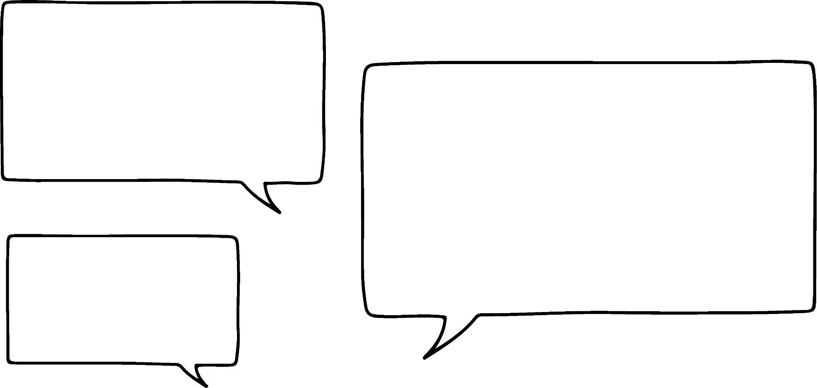
Cube numbers
Laura has put together these cubes.
She counted them and said
I have made a cube with 48 cubes
So 48 is a cube number.
Where is her mistake?
4
3
4
It is not a cube so 48 is not a cube number. She made a cuboid with lengths 4 by 4 by 3.

Slide 28
Cube numbers
Laura has put together these cubes.
She counted them and said
27 is not a cube number because I do not have a cube.
Explain why she is wrong.
4
3
2
She did not arrange them correctly. All the lengths should be the same. Each length of the cube must be 3 to make the cube number 27.

Slide 29
Cube numbers
27 is a cube number as it makes this cube.
3
3
3

Slide 30
Cube numbers
Identify all the cube numbers from the list below.
1 2 3 4 8 9 10
16 25 27 36 40 49
64 100 121 125 169
1000

Slide 31
Cube numbers
2) Put the following numbers in the Venn diagram:
1 3 4 8 9
16 25 27 36 40 49
64 125 216 1000
Square numbers
Cube numbers

Slide 32
Cube numbers
3) Fill in the number to make the calculation correct.
The number in the SQUARE is a square number
The number in the CUBE is a cube number.
⬜ + 🧊 = 31
⬜ + 🧊 = 33
⬜ + 🧊 = 225
⬜ + ⬜ + 🧊 = 104
🧊 + 🧊 + 🧊 = 36

Slide 33
Cube numbers
Identify all the cube numbers from the list below.
1 2 3 4 8 9 10
16 25 27 36 40 49
64 100 121 125 169
1000

Slide 34
Cube numbers
2) Put the following numbers in the Venn diagram:
1 3 4 8 9
16 25 27 36 40 49
64 125 216 1000
Square numbers
Cube
numbers
36
125
16
1
27
25
216
64
1000
49
4
8
40
9
3

Slide 35
Cube numbers
3) Fill in the number to make the calculation correct.
The number in the SQUARE is a square number
The number in the CUBE is a cube number.
4
⬜ + 🧊 = 31
⬜ + 🧊 = 33
⬜ + 🧊 = 225
⬜ + ⬜ + 🧊 = 104
🧊 + 🧊 + 🧊 = 36
27
25
8
100
125
36
4
64
1
8
27

Slide 36
Square and cube numbers
When there are two repeated integers, the product is a square number.
Forming a square array can help identify a square number.
When there are three repeated integers, the product is a cube number.
Forming a cube using blocks can help identify a cube number.

Slide 37

© Oak National Academy 2023.
Produced in partnership with Mathematics in Education and Industry.
Licensed on the Open Government Licence v3.0, except where otherwise stated. See Oak terms and conditions.

